Slide 1
Topics
Visual Computing Center, SZU

Slide 2
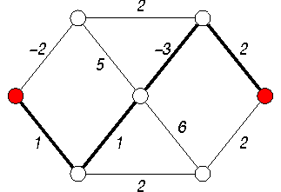
Easy: shortest path
https://en.wikipedia.org/wiki/Shortest_path_problem
Comparison of different shortest path algorithms
Shortest path on graph with negative weights?
Shortest path on planar graph? (HARD)
Some algorithms of Shortest Path:
Dijkstra, Bellman Ford, SPFA, A*, Floyd, etc..

Slide 3
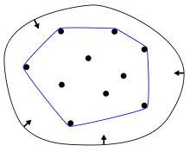
Easy: Convex Hull(凸包)
Given a point set, the convex hull of it is the smallest convex shape that contains the whole set
A gentle introduction to the convex hull problem
Various methods for solving convex hull problem
Methods: Naive, Graham Scan, Gift Warping etc.
What about 3D convex hull? and N-D ?

Slide 4
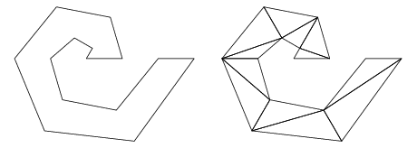
Easy: Polygon Triangulation(三角化)
A triangulation is a subdivision of a planar object into triangles
https://en.wikipedia.org/wiki/Polygon_triangulation
List three or more algorithms of polygon triangulation and compare their performance.

Slide 5
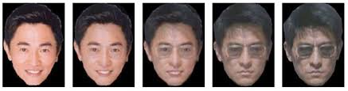
Medium: Image morphing
Image morphing is a special effect that changes one image into another through a seamless transition.
https://en.wikipedia.org/wiki/Morphing
http://graphics.cs.cmu.edu/courses/15-463/2011_fall/Lectures/morphing.pdf

Slide 6
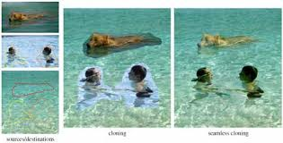
Medium: Seamless Image Editing
How to seamlessly place a region of an image to another?
Poisson Image Editing, check this paper, write a summary and compare it with older methods.

Slide 7
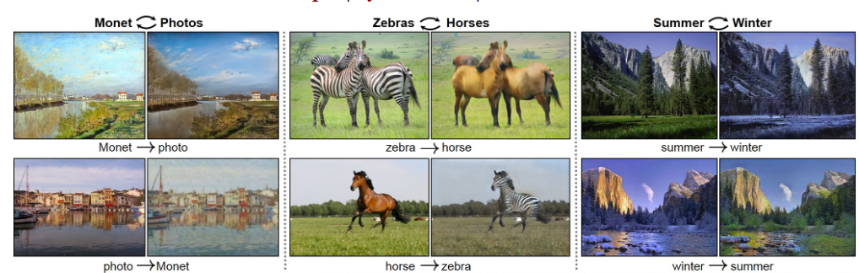
Medium: Image-to-image translation
https://phillipi.github.io/pix2pix/
https://junyanz.github.io/CycleGAN/

Slide 8
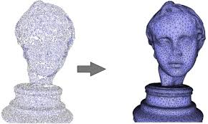
Hard: Points to mesh
How computer stores geometry data? (points, mesh, voxels, implicit, grammar etc.) and how to convert one form to the other?
Please focus on how to convert point clouds to mesh surface.
https://en.wikipedia.org/wiki/Point_cloud
https://en.wikipedia.org/wiki/Polygon_mesh
http://graphics.stanford.edu/courses/cs468-10-fall/LectureSlides/03_Surface_Reconstruction.pdf
http://graphics.stanford.edu/courses/cs468-10-fall/LectureSlides/04_Surface_Reconstruction.pdf
http://hhoppe.com/poissonrecon.pdf

Slide 9
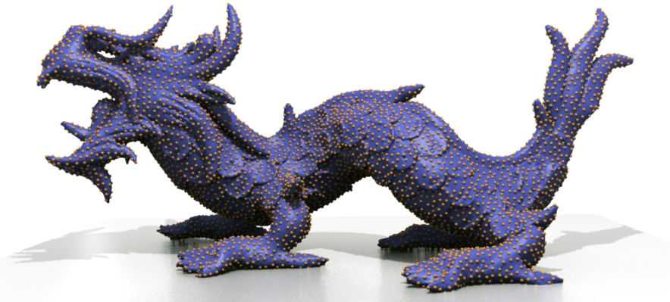
Hard: Mesh to points
How computer stores geometry data? (points, mesh, voxels, implicit, grammar etc.) and how to convert one form to the other?
Please focus on how to generate point clouds from mesh surface.
https://en.wikipedia.org/wiki/Point_cloud
https://en.wikipedia.org/wiki/Polygon_mesh
http://graphics.stanford.edu/courses/cs468-10-fall/LectureSlides/03_Surface_Reconstruction.pdf
http://graphics.stanford.edu/courses/cs468-10-fall/LectureSlides/04_Surface_Reconstruction.pdf
https://www.jasondavies.com/maps/random-points/
http://www.cs.jhu.edu/~misha/MyPapers/ToG13.pdf

Slide 10
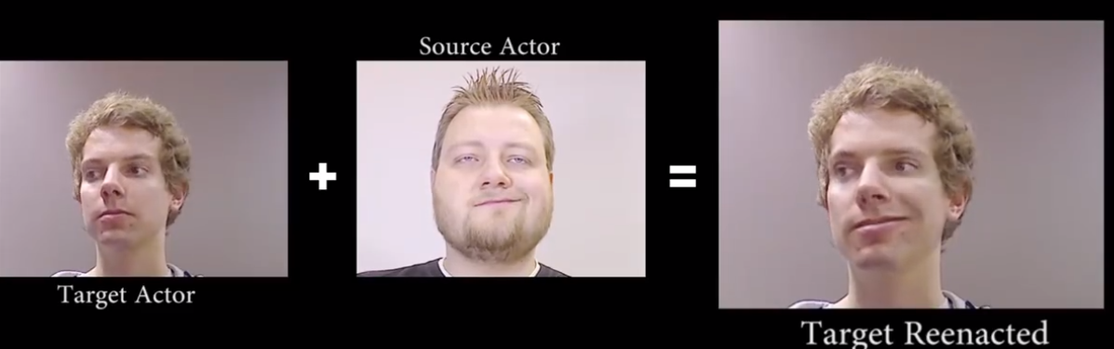
Hard: Expression Transfer
Check this to see how to transfer one’s expression to the other in real-time！
https://niessnerlab.org/papers/2015/10face/thies2015realtime.pdf
http://www.niessnerlab.org/projects/thies2015realtime.html

Slide 11
And more…
3d reconstruction from 2d images
pose estimation
mesh editing
texture synthesis
…

